Slide 1
Data Representation
Michael Cao

Slide 2
Topic 1: Number System
Michael Cao

Slide 3
Learning Objective
In this lesson, you will learn:
Number system of binary and hexadecimal

Slide 4
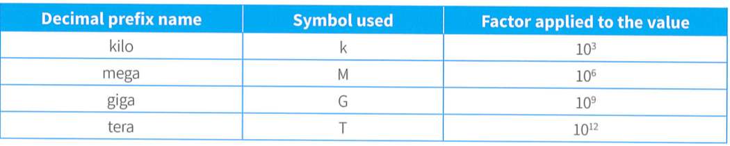
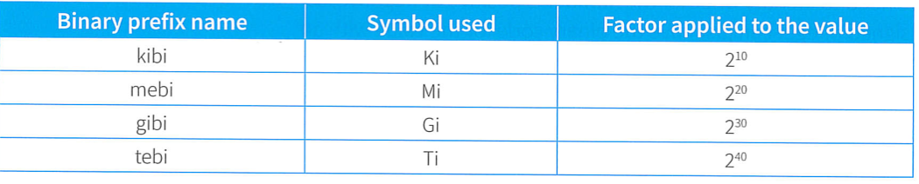
Number System
Binary number is the foundation in computer science:
Binary is used because switches only have ‘on’ and ‘off’ states
Hexadecimal is used because it’s easier for human to read
The key for transformation is to focus on the weight
Special attention for the definition of ‘prefix’
Activity: explore the using scenario of hexadecimal number

Slide 5

Calculation
We use two’s complement for addition:
If we use original number, there will cause error
Multiple ways to calculate the two’s complement
The philosophy is to find a number that have the same result with overflow
-128 – 127 is the range of two’s complement
Explore how to transfer a negative two’s complement to denary number directly
Practice for deriving the two’s complement, as well as addition calculation
We use logical shift as a way of multiple and division

Slide 6
Topic 2: Media and Compression
Michael Cao

Slide 7
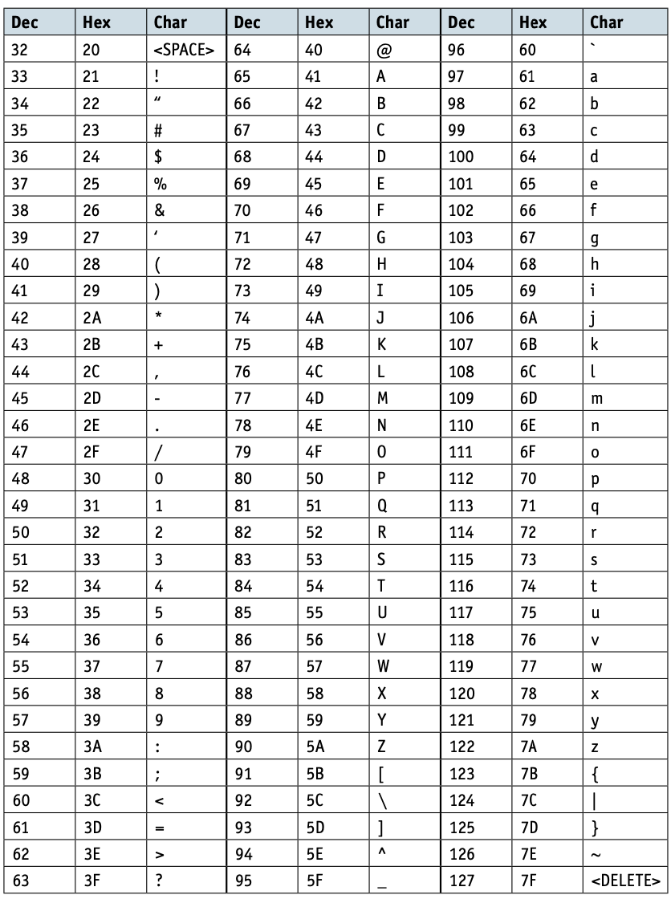
ASCII and Unicode
We need a coding scheme to store text in a computer:
ASCII: American Standard Code for Information Interchange
No need to remember each code, but know the rules
Limited characters with 1 byte length (Extended)
Unicode: Cover more characters with 2 bytes

Slide 8

Bitmap
Bitmap is generally used to store an image:
Pixel: the smallest component of bitmap. (essential information?)
Color depth: the number of bits used to represent one pixel
Resolution: image resolution and screen resolution
File Header: a set of bytes at the beginning identifies the files and contains information about the coding used

Slide 9
Sound
Sound is a continuous format of media:
ADC and DAC: convert between analogue and digital data
Sampling: taking measurements at regular intervals and storing the values
Sampling resolution: the number of bits used to store each sample
Sampling rate: the number of samples taken per second
Calculate the file size of images, sound files and videos

Slide 10
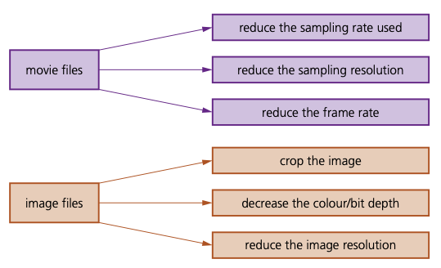
Compression
Compression is useful to reduce file size:
File Size: Calculated by unit and quantity. (also the logic of compression)
Lossless compression: original file can be restored
Coding map table (use code.org to explore)
Run-length encoding (consecutive repeating patterns)
Lossy compression: some data is lost permanently
Perceptual shaping
Crop or reduce resolution of depth
Relative mapping (adjacent frames in video)
Presentation: design / introduce a compression method by your own
Hint: Introduction can include from thesis or existed compression format

